Slide 1
What is Going On?
How do cognitive processes Affect Information gathered in Research interviews: - a work in progress
AES Conference September 2011
by David Roberts
RobertsBrown
www.robertsbrown.com
david@robertsbrown.com

Slide 2
Thesis
Thesis on psychological basis of projective techniques
Reviewed the literature on
  qualitative interviewing,
  cognitive schema and
  use of projective stimuli.
Conducted interviews using one projective technique
Followed up with cognitive interviews to explore the cognitive processing

Slide 3
Outline
Describe projection
Talk about schemata as a way of understanding how projection works
Describe the techniques I used
  TAT
  Category Instance Generation
Outline some of what happened
Discuss

Slide 4
RobertsBrown

Slide 5
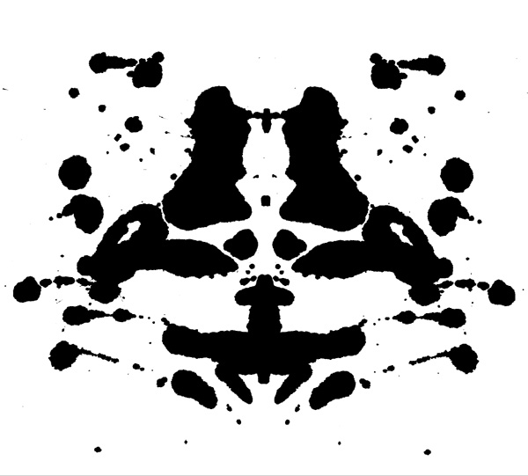
Rorschach

Slide 6
RobertsBrown

Slide 7
Haire’s Shopping List I
Pound and a half of hamburger
2 loaves Wonder bread
bunch of carrots
1 can Rumford's Baking Powder
Nescafe instant coffee
2 cans Del Monte peaches
5 lbs. potatoes

Slide 8
Haire’s Shopping List II
Pound and a half of hamburger
2 loaves Wonder bread
bunch of carrots
1 can Rumford's Baking Powder
1 lb. Maxwell House Coffee (Drip Ground)
2 cans Del Monte peaches
5 lbs. potatoes

Slide 9
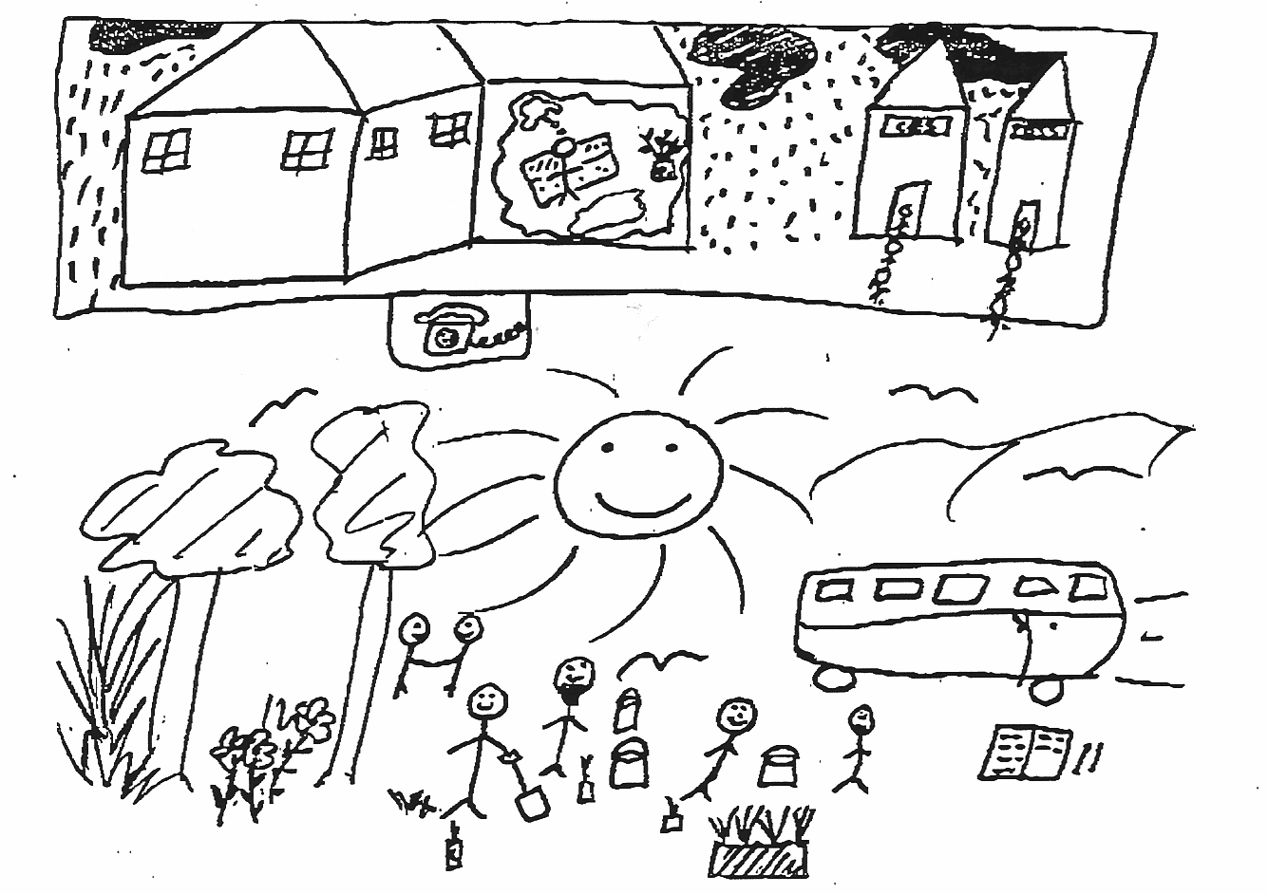
Drawings

Slide 10
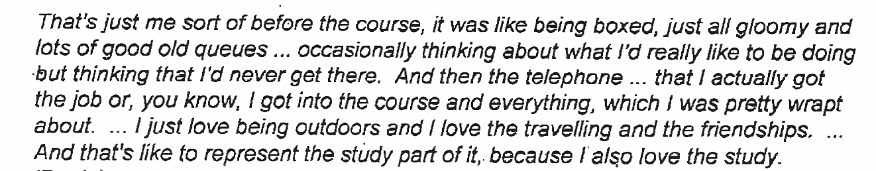

Slide 11
Use of Projection
Allow the researcher to get past “defences” (Donoghue 2000)
get “beneath the surface” (Keegan 2009) responses
collect information that is hidden from direct questioning
when dealing with children (Keats 1993; Patton 2002)
those who are ‘anxious’ (Keats 1993)
where language is a problem.

Slide 12
How do they work?
Participants “need to make sense of, by drawing on their own experiences, thoughts, feelings and imagination.” (Catterall & Ibbotson 2000)
Make the familiar unfamiliar – problematic (Mannay 2010)
“engage in various acts of orientation” towards the issue …
“the researcher is able to gain insight into participants’ interpretative processes and the multi-faceted nature of their ‘stock of knowledge’” (Jenkins et al 2010)

Slide 13
Most Behaviour is automatic or driven by emotions
Driving a car turning a corner
Going to the movies
“Most of what drives behaviour is below conscious awareness (adaptive unconscious)” (Gladwell 2005 quoted in Keegan 2010)

Slide 14
Schema
Socially constructed cognitive structure
Act without analysis of every detail
Triggered quickly form very few cues
Simplified representation of the world
Assumptions and emotional stances
Specific memories
Specific values

Slide 15





Slide 16
Thematic Apperception Testing
Describe the person in the picture
What would the person do when you hand over the report? How would they behave?
How would they use the report?

Slide 17
Cognitive Interview
Reviewed video
Asked them to tell me what they were thinking when the picked the photo,
  why that photo,
  if it reminded them of someone
Stopped whenever made a generalisation, used a metaphor, made a face, laughed etc.
Asked them to give me examples (Category Instance Generation)

Slide 18
What Happened
Most people talked about the person in the photo as if they were real
Several made the point they were responding to a photo but talked about the person
A lot of them talked about how their responses were stereotypes or cliches
“We shouldn’t make judgements” – but they did (even one person who was quite resistant to the idea)

Slide 19
About the Photo
Reminded me of a client
“empty suit” (110815M)
“He doesn’t look at it, he puts it on the table and gushes” (110815M)
“Subsequently, after I’ve left the room, I assume he passes the report onto someone else.” (110815M)
“… annoys the hell out of me when I read one of these academic papers where the theory is talking to itself about itself in complex language.” (110815M)

Slide 20
About the process -1
    “I was at the moment of handing over the report” (110815M)
    “Rush of images and sounds” (110815M)
Eliminated categories very quickly
Intuitive judgements very quickly
  elaborated and supported the judgement with words based on details in the photo
  “thoughtful and reflective second”
  Some tested the judgement or qualified it

Slide 21
About the process - 2
Responded to the person in the photo and to the photo itself
Responses based on ‘stereotypes’
    “demonstrate the cliches” (110815M)
    trust this cliché but not that
Personal theory
Based on experiences
  Frequent experiences
      “an amalgam of people” (110801A)
      “reminded me of a good number of experiences” (110815M)
  Memorable recent experience
  Experiences include reading and writing and imagination

Slide 22
Thoughts for analysis
Good support for the notion of schema
Salience of experience is crucial
Where do I go from here?

Slide 23
Bibliography
Catterall, M & Ibbotson, P. 2000. Using projective techniques in education research. British Educational Research Journal 26(2):245-247
Durgee, J.F. (1988) On Cezanne, hot buttons, and interpreting consumer storytelling, Journal of Consumer Marketing, Vol 5, Iss 4, pp. 47-51.
Donoghue, S. (2000) “Projective techniques in consumer research” in Journal of Family Ecology and Consumer Sciences, Vol 28,: 47-53, ISSN 0378-5254
Jacques D. “Projective Techniques: Eliciting Deeper Thoughts”, in Customer Input Journal, Internet WWW page, at URL: http://www.customerinput.com/journal/projective_techniques_eliciting_deeper_thoughts.asp version dated 30/9/20050
Jenkins, N., Bloor, M., Fischer, J., Berney, L. & Neale, J. (2010), “Putting it in context: the use of vignettes in qualitative interviewing” Qualitative Research Vol. 10, No. 2 pp..175-198
Mannay, D (2010) “Making the familiar strange: can visual research methods render the familiar setting more perceptible” Qualitative Research Vol. 10, No.1, pp.91-111

